Slide 1
Requirements Engineering

Slide 2
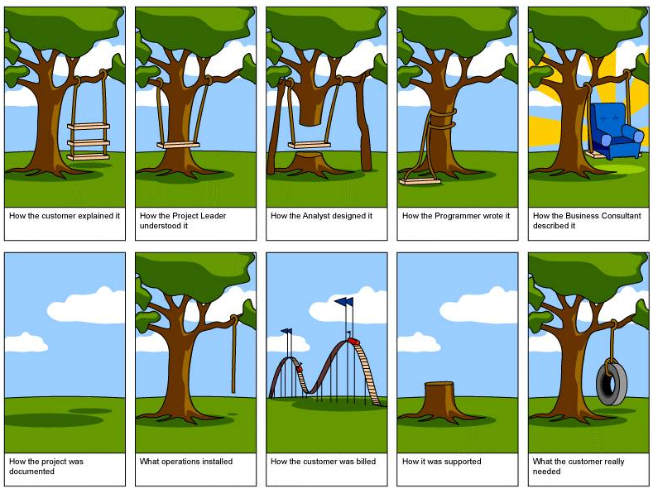
Project Swing!
Requirements Engineering
2

Slide 3

Annual IT application development statistics
• $250 Billion on 175,000 Projects
• 31% will be cancelled
• 53% will cost 189% of original estimates.
• Only 52% of required features and functions.
• Time overruns 82%
• $55 Billion dollars project waste
1. Lack of a Project Charter
2. Lack of User Involvement
3. Poorly Defined Requirements
3. Poorly Defined Requirements
4. Scope Creep
4. Scope Creep
5. Unrealistic Time Scales
6. Inadequate Testing
7. Lack of Resources
8. Use of Unfamiliar Tools
9. Political Infighting
10. Poor Project Management
Requirements Engineering
3

Slide 4

Requirement Engineering Basics
Requirement Definition
A requirement is a usable representation of a need. Requirements focus on understanding what kind of value could be delivered if a requirement is fulfilled. The nature of the representation may be a document (or set of documents), but can vary widely depending on the circumstances.
Requirements : A condition or capability needed by user to solve a problem or achieve an objective.
Requirement Engineering
Requirement Development
Requirement Management
Elicitation
Analysis
Specification
Validation
Traceability
Change management
Requirements Engineering
4

Slide 5


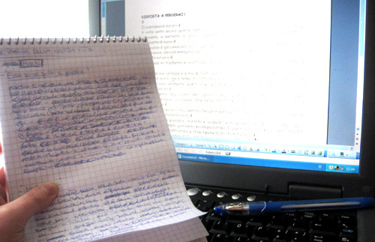
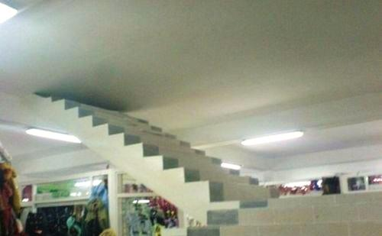
Requirement Development
Requirement Elicitation
Requirement Analysis
Requirement Specification
Requirement Validation
Requirements Engineering
5

Slide 6
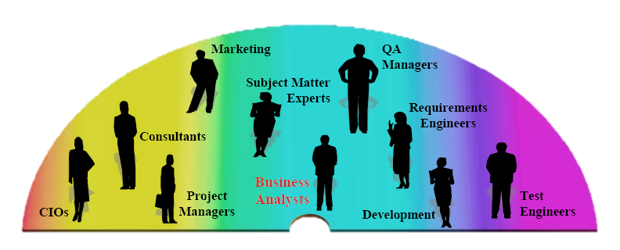
Ideal Requirements should be …
Agile User Stories
1 | SMART S: Specific M: Measurable (verifiable) A: Achievable/Appropriate R: Realistic/Relevant T: Timely/Time-bound
2 | Unambiguous
3 | Complete
4 | Correct
5 | Consistent
I | Independent
N | Negotiable
V | Valuable
E | Estimatable
S | Small
T | Testable
Business
IT
Requirements Engineering
6

Slide 7
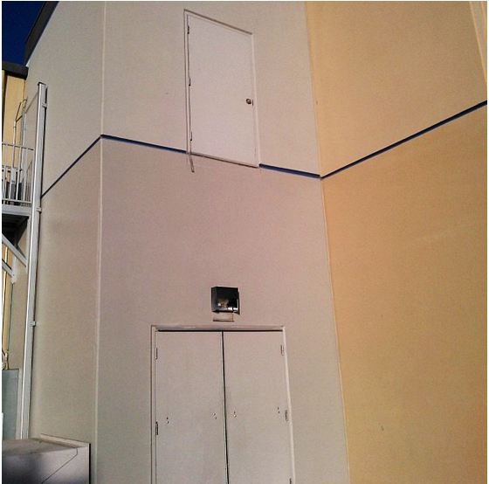
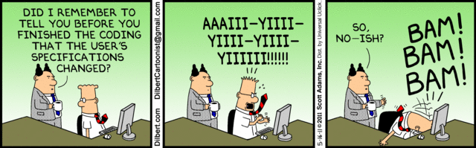
Requirement Management
Requirement Traceability
Oh we forgot about stairs !
Change Management
Requirements Engineering
7

Slide 8

Types of Requirements
8

Slide 9
Type of Requirements
BR
Business Requirements : Goals, Objectives, and Outcomes expected / required
UR
User Requirements : Needs Users / Stakeholder to achieve BR
SR
(FR & NFR )
Solution Requirements : Capabilities and qualities of solution
Functional Requirements | Usecases, Messages, Workflow, Approvals, Validations …
Non Functional Requirements | Security, Data Retention, Browser/ OS Compatibility, Backup, Throughput, Performance, Availability, Reliability, Certification …
Transitional Requirements | Data Conversion / Transfer, Training, Business Continuity
Requirements Engineering
9

Slide 10
Questions
Requirements Engineering
10

Slide 11

Thank you

